Slide 1
Pthreads

Slide 2
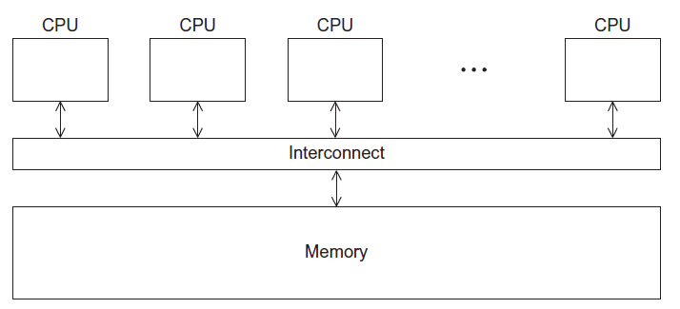
Shared Memory Architecture

Slide 3
Processes and Threads
A process is an instance of a running (or suspended) program.
Threads are analogous to a “light-weight” process.
In a shared memory program a single process may have multiple threads of control.

Slide 4
Logical View of Threads
Threads are created within a process
A process
Process hierarchy
T2
T4
T1
P1
shared code, data
and kernel context
sh
sh
sh
T5
T3
foo

Slide 5
Concurrent Thread Execution
Two threads run concurrently if their logical flows overlap in time
Otherwise, they are sequential (we’ll see that processes have a similar rule)
Examples:
Concurrent:
A & B, A&C
Sequential:
B & C
Thread A
Thread B
Thread C
Time

Slide 6
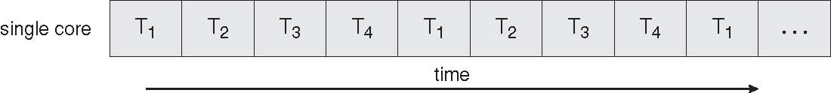
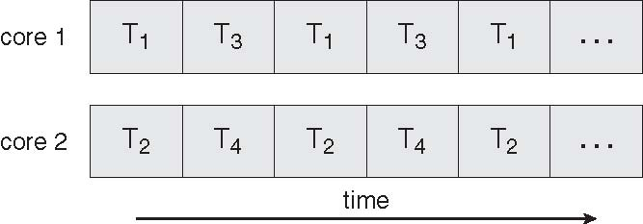
Execution Flow on one-core or multi-core systems
Concurrent execution on a single core system
Parallel execution on a multi-core system

Slide 7
Threading Models - 1
Kernel (1-1)
All threads are first class objects in the kernel
Scheduling in and by the kernel
Utilizes multi-processors efficiently
Syscalls do not block the other threads
High overhead for large number of threads

Slide 8
Theading Models - 2
User Space (N-1)
Single kernel process, multiple user threads
Low kernel overhead – threads are cheap
Scheduling is determined by the process
Syscalls block the whole process (and all the threads)
No efficiency on multi-processors

Slide 9
Threading Models - 3
Hybrid (M-on-N)
User both kernel threads and user threads
More complicated to implement
Requires changes to libraries
Scheduling is complicated
User space libraries must be synchronized with kernel version

Slide 10
State of the Art
Linux
Pre 2.6: LinuxThreads (1-1 with extras)
2.6 on: NPTL – Native POSIX Thread Library (1-1)
Windows
Threads, but not POSIX (1-1)

Slide 11
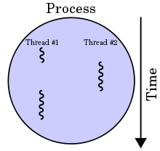
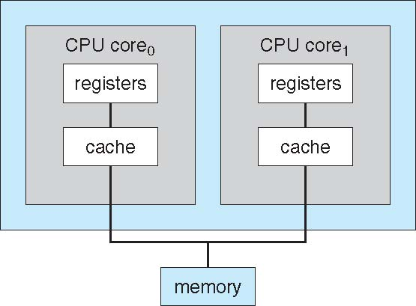
Benefits of multi-threading
Responsiveness
Resource Sharing
Shared memory
Economy
Scalability
Explore multi-core CPUs

Slide 12
Thread Programming with Shared Memory
Program is a collection of threads of control.
Can be created dynamically
Each thread has a set of private variables, e.g., local stack variables
Also a set of shared variables, e.g., static variables, shared common blocks, or global heap.
Threads communicate implicitly by writing and reading shared variables.
Threads coordinate by synchronizing on shared variables
Shared memory
s
s = ...
i: 2
i: 5
Private memory
i: 8
P0
P1
Pn
Notes:
Example: think of a thread as a subroutine that gets called on on processor, executed on another
Like concurrent programming on a uniprocessor (as studied in CS162).

Slide 13
Shared Memory Programming
Several Thread Libraries/systems
Pthreads is the POSIX Standard
Relatively low level
Portable but possibly slow; relatively heavyweight
OpenMP standard for application level programming
Support for scientific programming on shared memory
http://www.openMP.org
Java Threads
TBB: Thread Building Blocks
Intel
CILK: Language of the C “ilk”
Lightweight threads embedded into C
Notes:
POSIX = Portable Operating System Interface
Slow if needs to go to OS for every thread operation
Java threads built on POSIX threads:
Are objects (like other objects in Java)
(1) create Java thread object
(2) send it a message saying “run” etc

Slide 14
Overview of POSIX Threads
POSIX: Portable Operating System Interface for UNIX
Interface to Operating System utilities
PThreads: The POSIX threading interface
System calls to create and synchronize threads
In CSIL, compile a c program with gcc -lpthread
PThreads contain support for
Creating parallelism and synchronization
No explicit support for communication, because shared memory is implicit; a pointer to shared data is passed to a thread

Slide 15
POSIX Threads (PThreads)
For UNIX systems, implementations of threads that adhere to the IEEE POSIX 1003.1c standard are Pthreads.
Pthreads are C language programming types defined in the pthread.h header/include file.

Slide 16
Why Use Pthreads
The primary motivation behind Pthreads is improving program performance.
Can be created with much less OS overhead.
Needs fewer system resources to run.
View comparison of forking processes to using a pthreads_create subroutine. Timings reflect 50,000 processes/thread creations.

Slide 17
Threads vs Forks
PLATFORM | fork() |  |  | pthread_create()
 | REAL | USER | SYSTEM | REAL | USER | SYSTEM
AMD 2.4 GHz Opteron (8cpus/node) | 41.07 | 60.08 | 9.01 | 0.66 | 0.19 | 0.43
IBM 1.9 GHz POWER5 p5-575 (8cpus/node) | 64.24 | 30.78 | 27.68 | 1.75 | 0.69 | 1.1
IBM 1.5 GHz POWER4 (8cpus/node) | 104.05 | 48.64 | 47.21 | 2.01 | 1 | 1.52
INTEL 2.4 GHz Xeon (2 cpus/node) | 54.95 | 1.54 | 20.78 | 1.64 | 0.67 | 0.9
INTEL 1.4 GHz Itanium2 (4 cpus/node) | 54.54 | 1.07 | 22.22 | 2.03 | 1.26 | 0.67

Slide 18
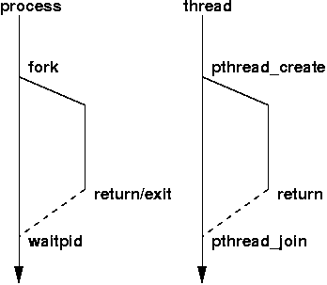
Creation of Unix processes vs. Pthreads

Slide 19
Designing Pthreads Programs
Pthreads are best used with programs that can be organized into discrete, independent tasks which can execute concurrently.
Example: routine 1 and routine 2 can be interchanged, interleaved and/or overlapped in real time.

Slide 20
How to Compile
#include <pthread.h>
gcc myprog.c –o myprog –l pthread

Slide 21
thread creation
int pthread_create(pthread_t *thread,
pthread_attr_t *attr,
void* (*start_routine)(void*),
void *arg);
Create a thread and run the start_routine
attr is usually NULL, don’t mess with it

Slide 22
Example
#include <pthread.h>
int val = 0;
void *thread(void *vargp) {
val = (int)vargp;
}
int main() {
int i;
pthread_t tid;
pthread_create(&tid, NULL, thread, (void *)42);
pthread_join(tid, NULL);
printf("%d\n",val);
}

Slide 23
sched_yield
#include <sched.h>
#include <unistd.h>
int sched_yield (void);
Yield the processor to another thread
Useful on uni-processor

Slide 24
Who am I
pthread_t pthread_self(void)
Uses:
Debugging
Data structures indexed by thread
pthread_equal: compare two pthread_t

Slide 25
Relationships
Marriage:
pthread_join – I will wait for you forever
Good bye
pthread_exit – I am going away now
Death
pthread_cancel – please die
Divorce:
pthread_detach – never talk to me again

Slide 26
pthread_join
int pthread_join(pthread t, void *data)
Wait until the thread exits and return the exit data. This call blocks!
Performs a detach after the join succeeds
Return values:
0: successful completion
EINVAL: thread is not joinable
ESRCH: no such thread
EDEADLK: a deadlock was detected, or thread specifies the calling thread

Slide 27
pthread_exit
void pthread_exit(void *data)
Stops execution of this thread
Return data to anyone trying to join this thread
Don’t call from the main thread, use exit()

Slide 28
Example
#include <pthread.h>
void *thread(void *vargp) {
pthread_exit((void*)42);
}
int main() {
int i;
pthread_t tid;
pthread_create(&tid, NULL, thread, NULL);
pthread_join(tid, (void **)&i);
printf("%d\n",i);
}

Slide 29
pthread_cancel
Die you !@$#@
int pthread_cancel(pthread_t thread)
return values:
0: ok
EINVAL: thread is invalid
ESRCH: no such thread

Slide 30
pthread_cancel
Three phases
Post a cancel request
Deliver to the target thread at the next cancellation point
Call cleanup routines and die

Slide 31
pthread_detach
I never want to see this thread again.
int pthread_detach(pthread_t thread)
Return values:
0 - ok
EINVAL – thread is not joinable
ESRCH – no such thread
On some systems, exit does not cause the program to exit until all non-detached threads are finished

Slide 32
Review: Exiting threads
Four options
Exit from start routine
Call pthread_exit
Call exit
Killed by pthread_cancel

Slide 33
Review
pthread_create
pthread_join
pthread_detach
pthread_exit
pthread_cancel
pthread_self
pthread_equal
sched_yield

Slide 34
C function for starting a thread
pthread.h
One object for each thread.
pthread_t
int pthread_create (
pthread_t* thread_p /* out */ ,
const pthread_attr_t* attr_p /* in */ ,
void* (*start_routine ) ( void ) /* in */ ,
void* arg_p /* in */ ) ;

Slide 35
A closer look (1)
int pthread_create (
pthread_t* thread_p /* out */ ,
const pthread_attr_t* attr_p /* in */ ,
void* (*start_routine ) ( void ) /* in */ ,
void* arg_p /* in */ ) ;
We won’t be using, so we just pass NULL.
Allocate before calling.

Slide 36
A closer look (2)
int pthread_create (
pthread_t* thread_p /* out */ ,
const pthread_attr_t* attr_p /* in */ ,
void* (*start_routine ) ( void ) /* in */ ,
void* arg_p /* in */ ) ;
Pointer to the argument that should
be passed to the function start_routine.
The function that the thread is to run.

Slide 37
Function started by pthread_create
Prototype: void* thread_function ( void* args_p ) ;
Void* can be cast to any pointer type in C.
So args_p can point to a list containing one or more values needed by thread_function.
Similarly, the return value of thread_function can point to a list of one or more values.

Slide 38
Wait for Completion of Threads
pthread_join(pthread_t *thread, void **result);
Wait for specified thread to finish. Place exit value into *result.
We call the function pthread_join once for each thread.
A single call to pthread_join will wait for the thread associated with the pthread_t object to complete.

Slide 39
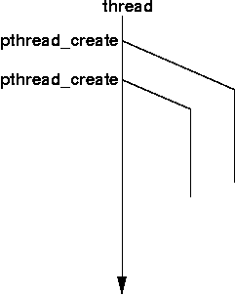
Example of Pthreads
#include <pthread.h>
#include <stdio.h>
void *PrintHello(void * id){
printf(“Thread%d: Hello World!\n", id);
}
void main (){
pthread_t thread0, thread1;
pthread_create(&thread0, NULL, PrintHello, (void *) 0);
pthread_create(&thread1, NULL, PrintHello, (void *) 1);
}

Slide 40
Example of Pthreads with join
#include <pthread.h>
#include <stdio.h>
void *PrintHello(void * id){
printf(“Hello from thread %d\n", id);
}
void main (){
pthread_t thread0, thread1;
pthread_create(&thread0, NULL, PrintHello, (void *) 0);
pthread_create(&thread1, NULL, PrintHello, (void *) 1);
pthread_join(thread0, NULL);
pthread_join(thread1, NULL);
}

Slide 41
Some More Pthread Functions
pthread_yield();
Informs the scheduler that the thread is willing to yield
pthread_exit(void *value);
Exit thread and pass value to joining thread (if exists)
Others:
pthread_t me; me = pthread_self();
Allows a pthread to obtain its own identifier pthread_t thread;
Synchronizing access to shared variables
pthread_mutex_init, pthread_mutex_[un]lock
pthread_cond_init, pthread_cond_[timed]wait

Slide 42
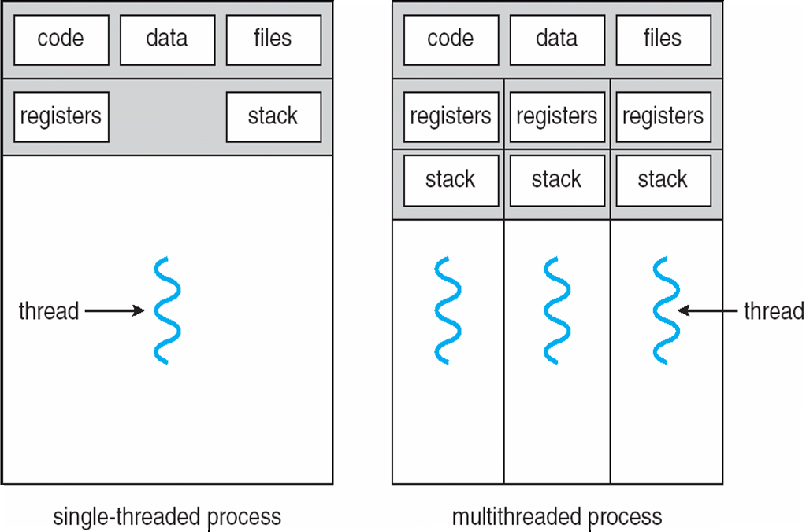
Difference between Single and Multithreaded Processes
Shared memory access for code/data
Separate control flow -> separate stack/registers

